Slide 1





Time Series Forecasting

Slide 2
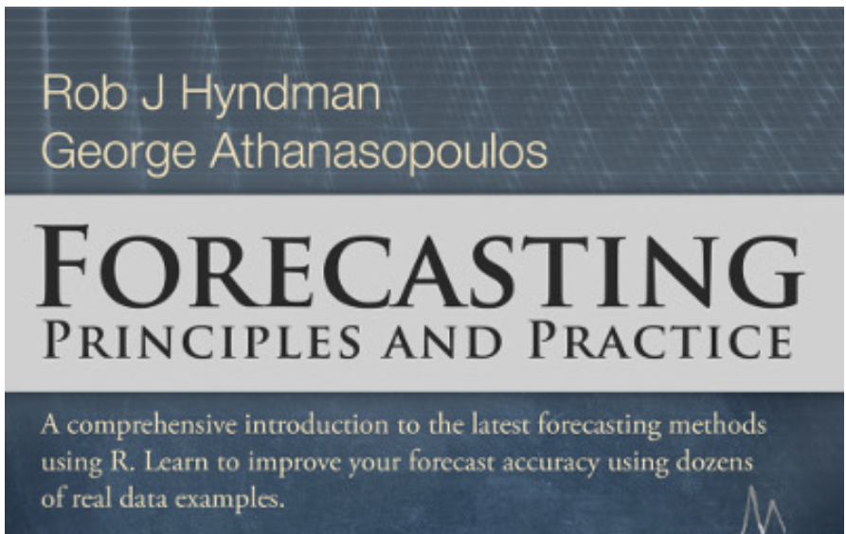
Overview
Forecasting Types
Time Series Components
Moving averages
Classic Decomposition
Autocorrelation
ARIMA models
https://otexts.com/fpp2/index.html

Slide 3
Types of Forecasting
Quantitative Forecasting
Qualitative (Judgmental) Forecasting
if historical data exists
if past patterns are reasonable to continue
subjective expert opinion
when new market conditions occur
Examples:
Regression
ARIMA
Delphi
Market Research
https://otexts.com/fpp2/data-methods.html
Notes:
short-term – “personnel, production and transportation scheduling” (for demand)
medium-term – ”needed to determine future resource requirements, in order to purchase raw materials, hire new staff, or buy machinery”
long-term – ”used for strategic planning. They must include environmental factors, market opportunities or internal resources”
quantitative forecasting. Used when:
historical data is available
it is reasonable to assume that some aspects of the patterns will continue in the future
qualitative forecasting:
a company/product enters new market
there is no historical information
when there are completely new market conditions
Delphi – point is to reduce individual expert bias by aggregating across multiple expert forecasts:
have a panel of experts assembled
interview each individually about their forecast
summarise all expert forecasts and feedback to participants
continue until satisfactory. (end goal is an aggregated forecast)
Market research
taking new products to potential customers and researching their response

Slide 4
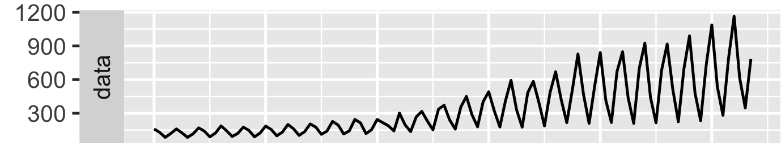
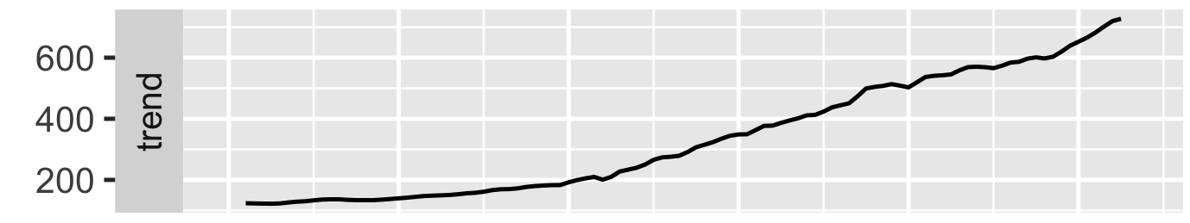
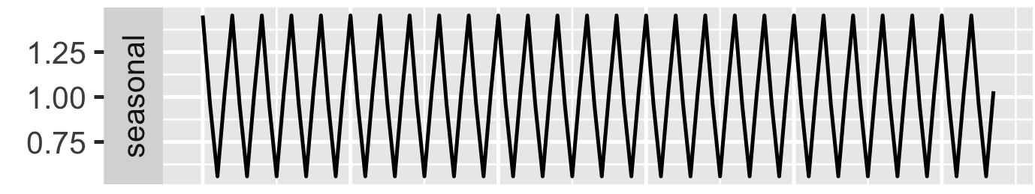
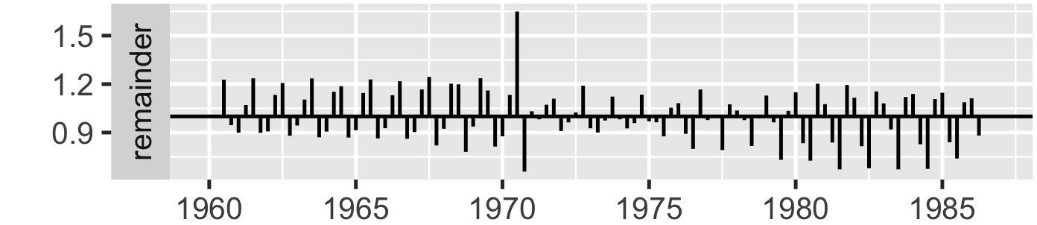
Time Series Components
Gas consumption in the UK
Notes:
”The trend provides information on longer-term movements in the seasonally adjusted data series over several years.”
”The cycle is a sequence of smoother fluctuations around the longer-term trend in part characterized by alternating periods of expansion and contraction.”
“The irregular component (the remainder) of a time series can represent unanticipated economic events or shocks (for example, strikes, disruptions, natural disasters, unseasonable weather, etc.) or can simply arise from noise in the measurement of the unadjusted data."
- https://www.statcan.gc.ca/en/dai/btd/tce-faq

Slide 5
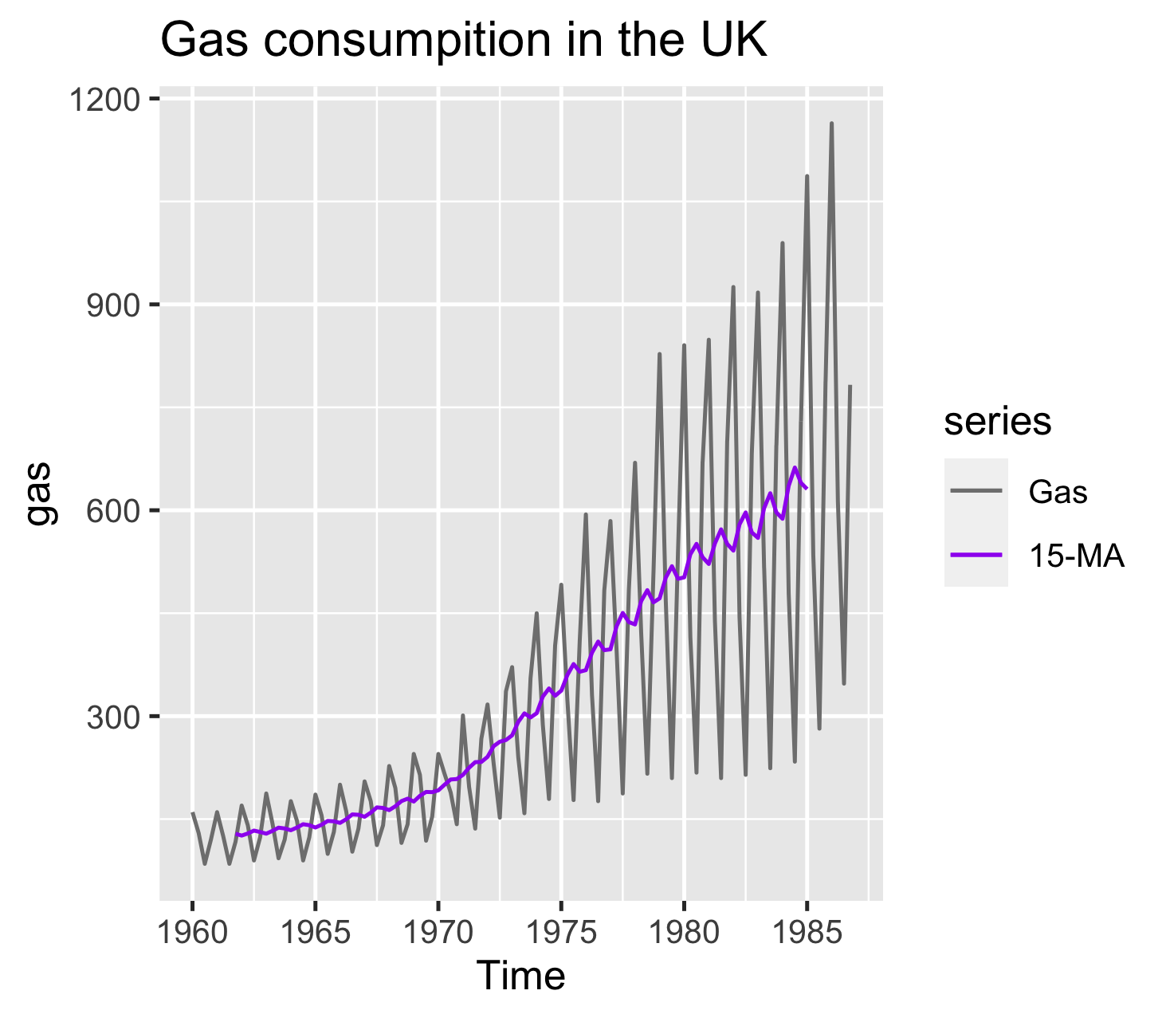
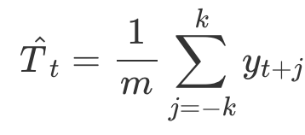
Moving average smoothing of order m=2k+1
Estimates the trend-cycle
If order is odd:
window is symmetrical
average is centered
Notes:
“A moving average is a time series constructed by taking averages of several sequential values of another time series. It is a type of mathematical convolution.”
Centered Moving Average:
center_ma(t) = mean(obs(t-1), obs(t), obs(t+1))
used as a general method to remove trend and seasonal components from a time series, a method that we often cannot use when forecasting
Trailing Moving Average
trail_ma(t) = mean(obs(t-2), obs(t-1), obs(t))
Trailing moving average only uses historical observations and is used on time series forecasting.
7-MA for intuition
- https://robjhyndman.com/papers/movingaverage.pdf

Slide 6
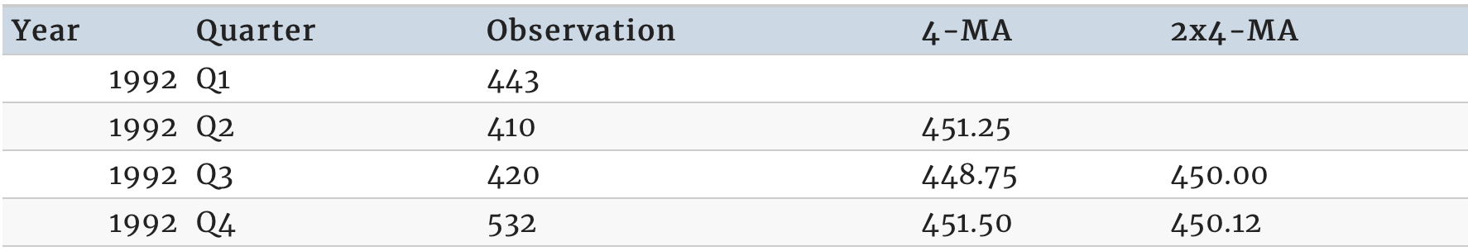
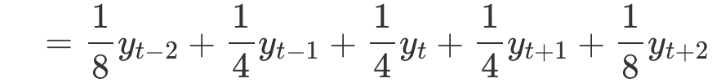
Moving averages of moving averages
An even order MA followed by an even order MA makes it symmetric
2x4-MA – find 4-MA and apply 2-MA on findings
https://otexts.com/fpp2/moving-averages.html
Notes:
An even order MA followed by an even order MA makes it symmetric. The result is now a weighted average of observations that is symmetric.
The power of using 4-MA or 12-MA comes from matching the seasonality (Q{1,2,3,4}, months 1-12).

Slide 7
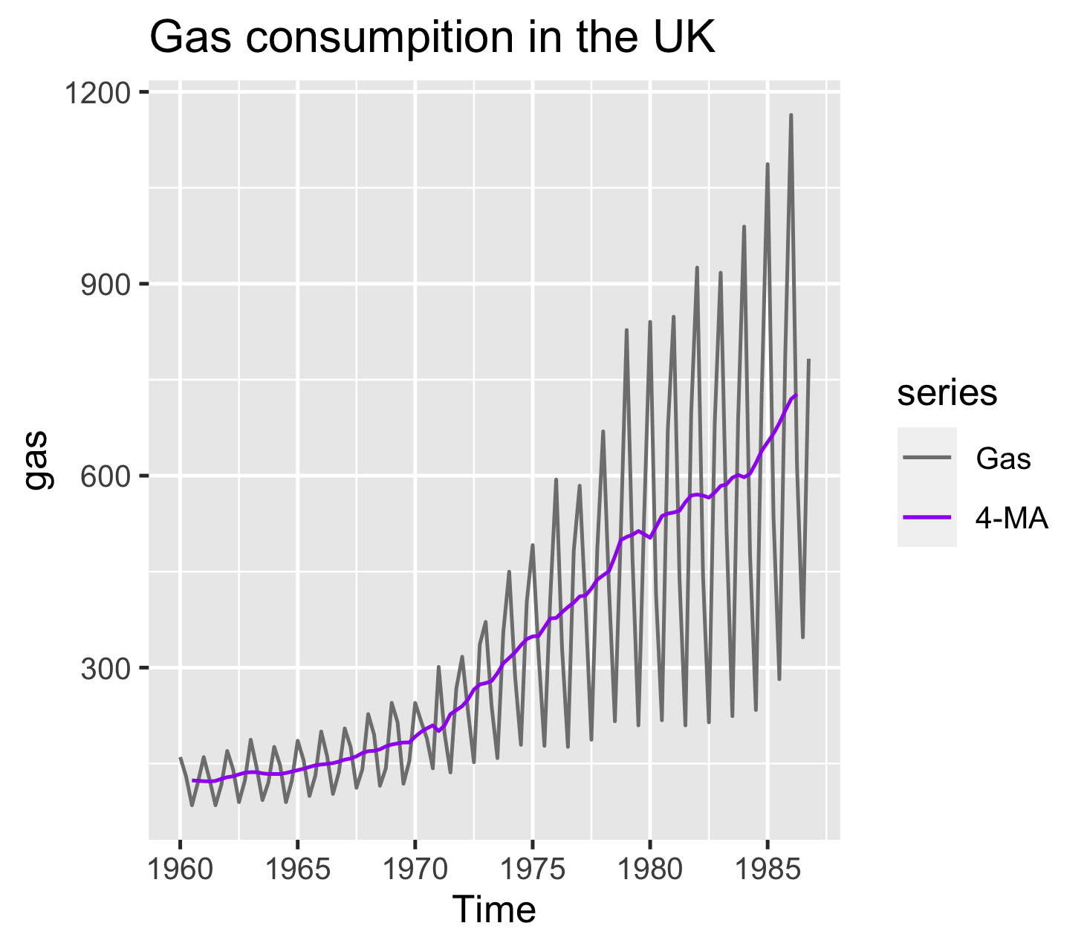
Moving averages of moving averages
15-MA
2x4-MA
Notes:
R will automatically center an even-order MA.
Gas consumption has a strong seasonal component, thus averaging on a quarter-basis gives a less ragged and more reasonable smoothing.

Slide 8
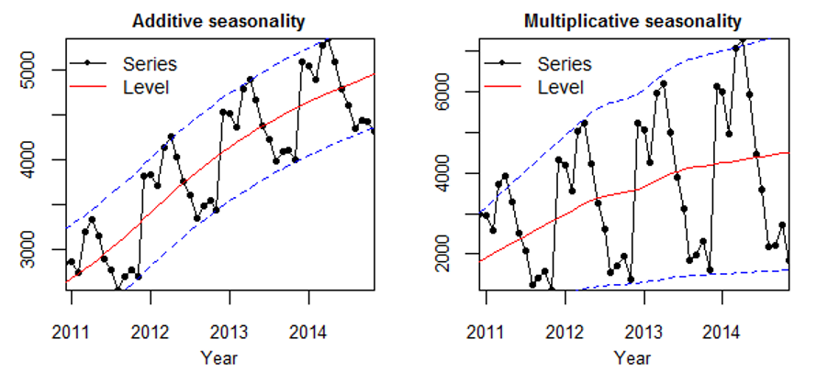
Seasonality Forms
https://kourentzes.com/forecasting/2014/11/09/additive-and-multiplicative-seasonality/
Notes:
The multiplicative seasonality exhibits a change of the seasonality magnitude, whereas in the additive version magnitude remains as if constant.

Slide 9
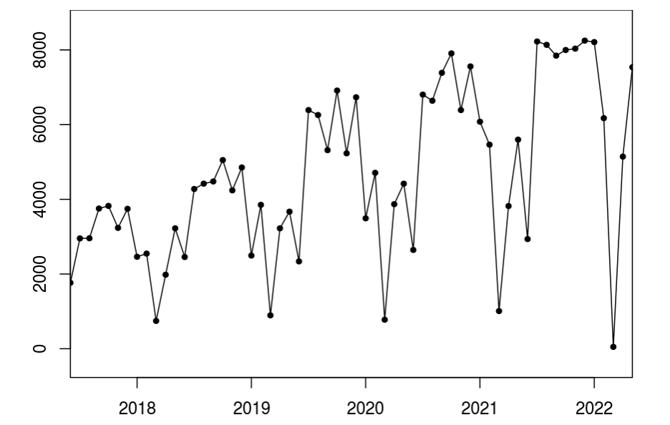
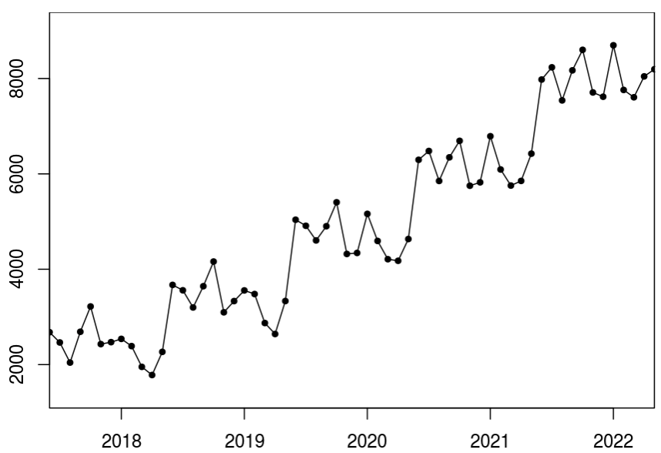
Seasonality Forms: Exercise
Multiplicative Seasonality
Additive Seasonality
https://kourentzes.com/forecasting/2014/11/09/additive-and-multiplicative-seasonality/

Slide 10
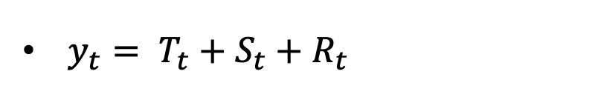
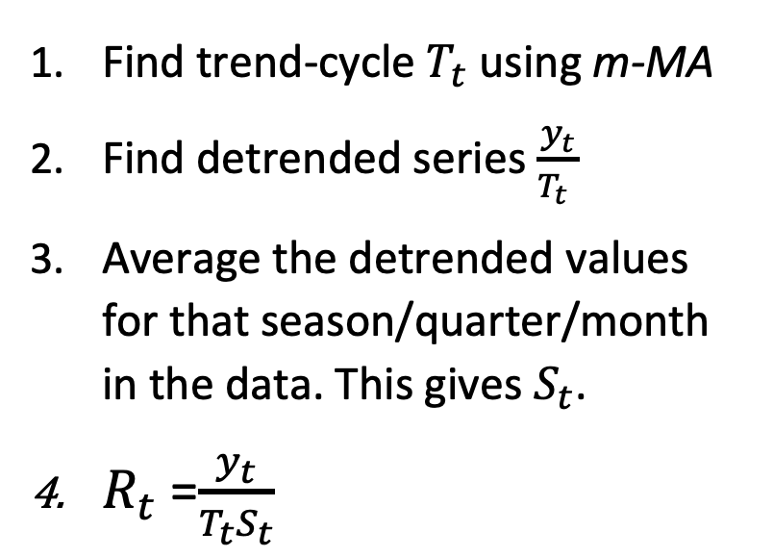
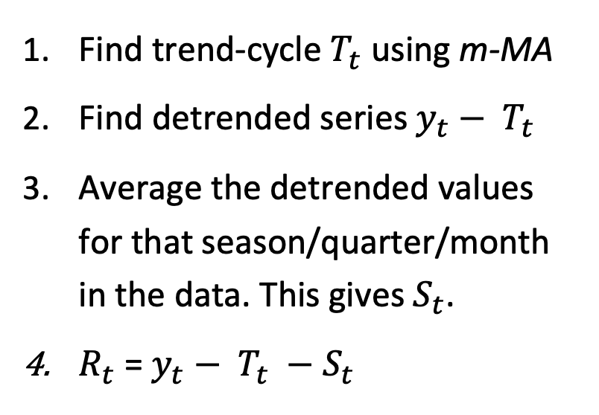
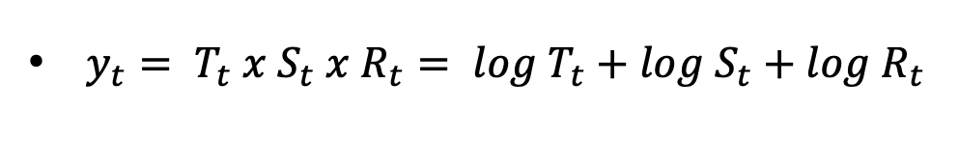
Classical Decomposition
Additive Decomposition
Multiplicative Decomposition
$y_{t}= T_{t}+S_{t}+R_{t}$
$y_{t}= T_{t} x S_{t} x R_{t}= log T_{t}+log S_{t}+log R_{t}$
Find trend-cycle $T_{t}$ using m-MA
Find detrended series $y_{t}− T_{t}$
Average the detrended values for that season/quarter/month in the data. This gives $S_{t}$.
$R_{t}$ = $y_{t}− T_{t} −S_{t}$
Find trend-cycle $T_{t}$ using m-MA
Find detrended series $\frac{y_{t}}{T_{t} }$
Average the detrended values for that season/quarter/month in the data. This gives $S_{t}$.
$R_{t}$ =$\frac{y_{t}}{T_{t}S_{t}}$
https://otexts.com/fpp2/decomposition.html
https://magoosh.com/statistics/making-sense-of-time-series-data/
Notes:
Additive Decomposition is most appropriate if the magnitude of the seasonal fluctuations does not change
A drawback of using a centered MA is that the first and the last m/2 values will be missed.

Slide 11
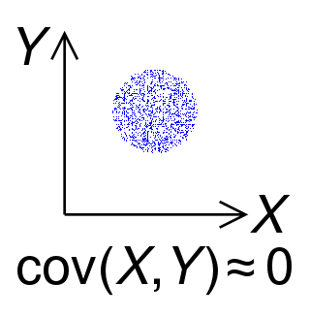
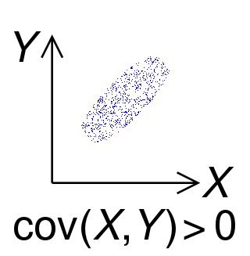
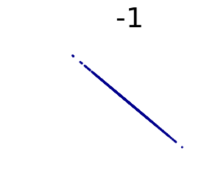
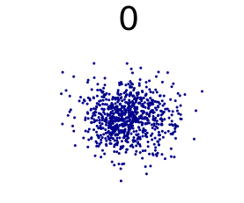
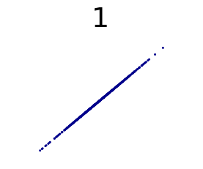
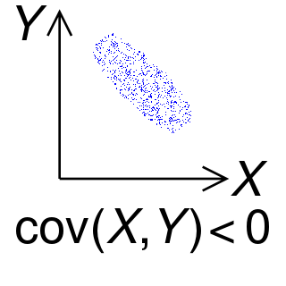
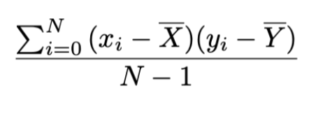
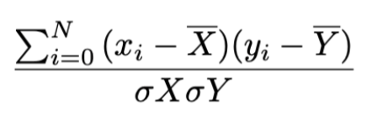
Autocorrelation: Prerequisites
Covariance
Correlation (Pearson’s coefficient)
https://en.wikipedia.org/wiki/Covariance
https://en.wikipedia.org/wiki/Correlation
Notes:
Covariance measures the degree to which to random variables are linearly related. But it is unbounded & unnormalized.
Whereas Correlation is a coefficient between -1 and 1 and thus normalizes the covariance.

Slide 12
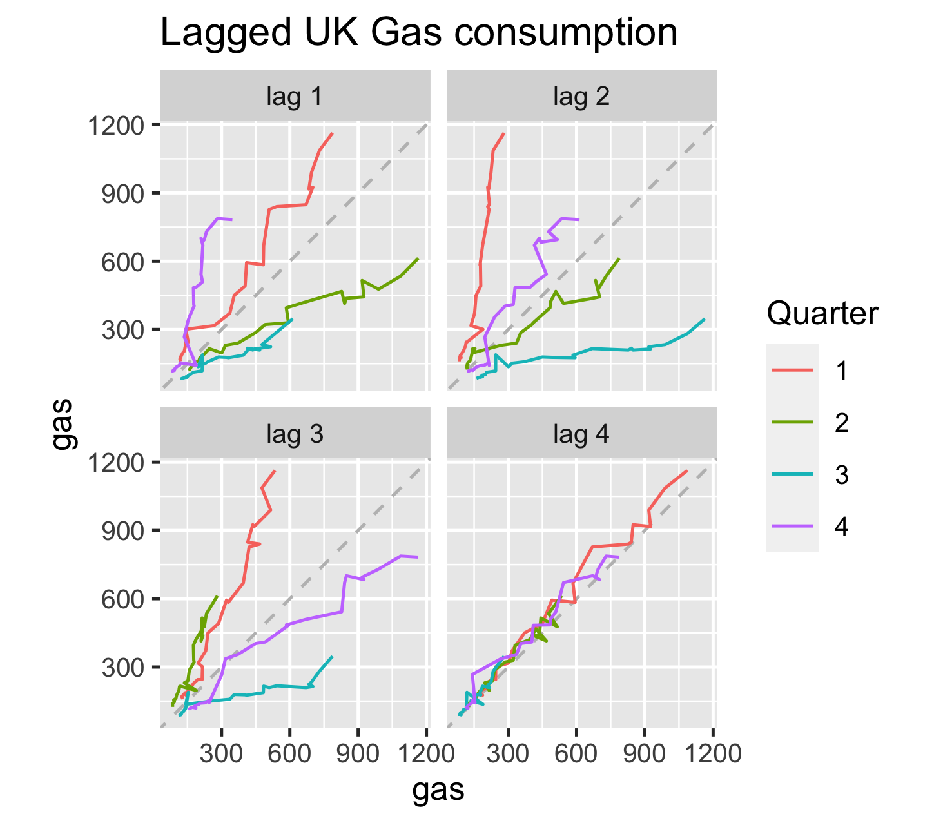
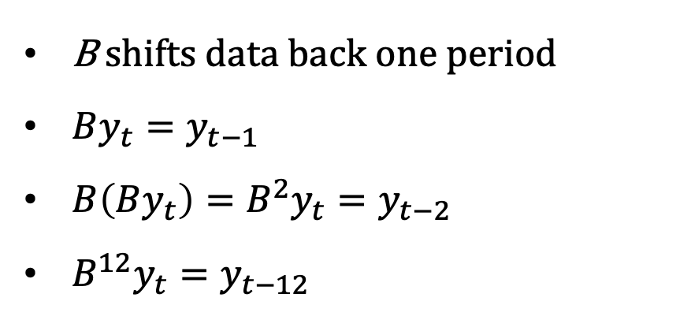
Autocorrelation: Lags & Backshift operator
B shifts data back one period
$By_{t}=y_{t−1}$
$B\left(By_{t}\right)=B^{2}y_{t}=y_{t−2}$
$B^{12}y_{t}=y_{t−12}$
Notes:
Lagged time series are essentially the original series but delayed over time interval.
B, operating on yt, has the effect of shifting the data back one period
Backshift is useful for differencing

Slide 13
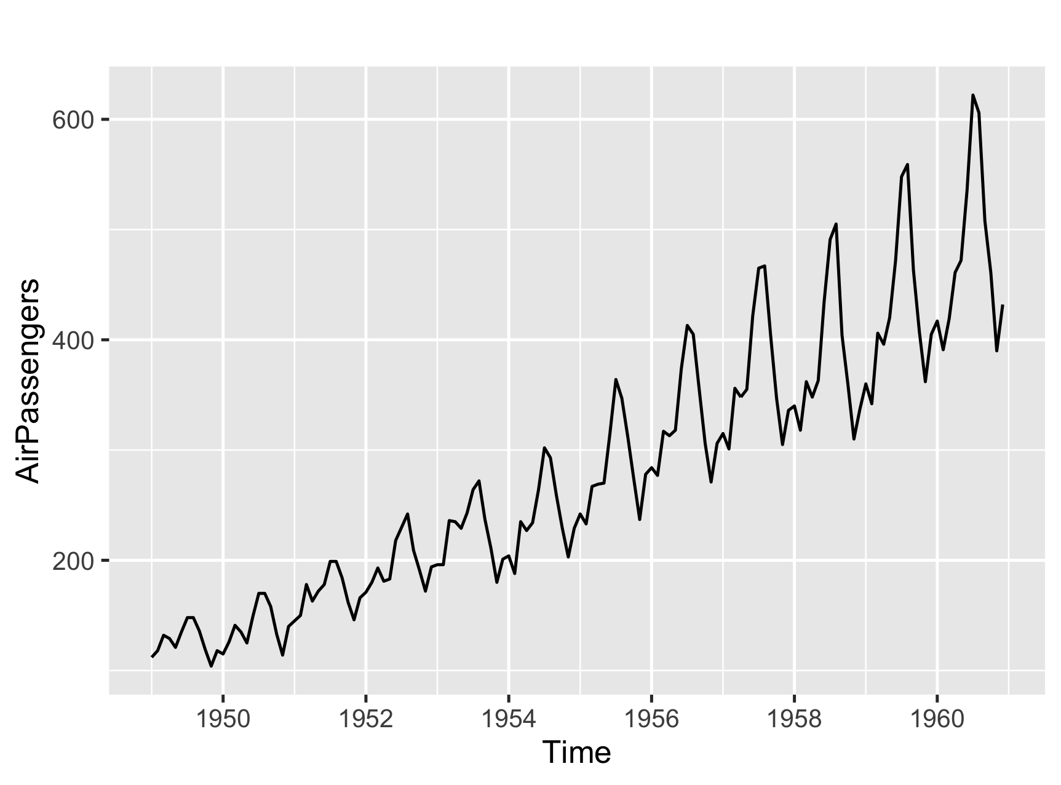
Air Passengers Dataset

Slide 14
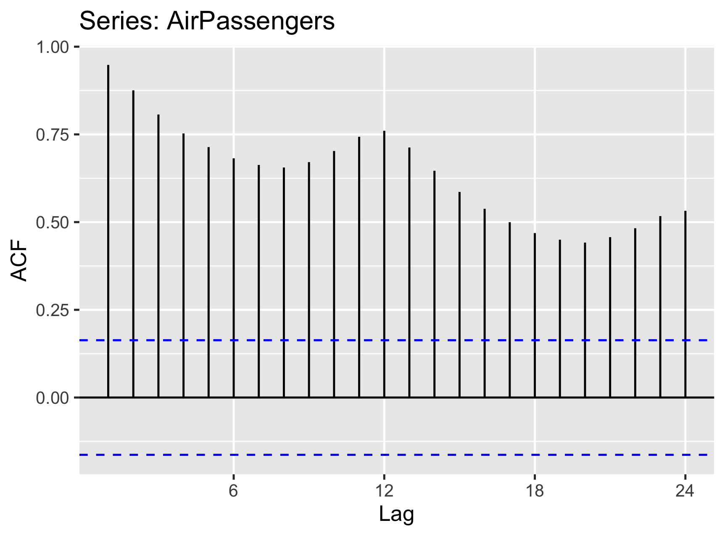
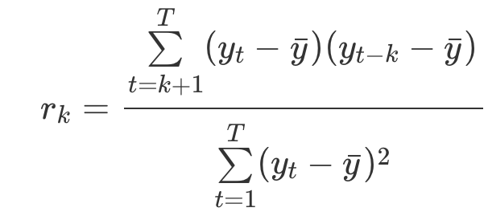
Auto-Correlation Function (ACF)
Autocorrelation coefficient
Notes:
”To detect non-randomness in data.
To identify an appropriate time series model if the data are not random.” - https://www.itl.nist.gov/div898/handbook/eda/section3/eda35c.htm
“what is different from the general correlation formula — we are always subtracting the mean of the original series! Because we create the lags, the mean of the original series and the lagged ones will not be the same.
in the denominator, we divide by the variance of the original series. In Pearson’s correlation coefficient, we would divide by the multiplication of the standard deviations of the two considered variables.” - https://towardsdatascience.com/a-step-by-step-guide-to-calculating-autocorrelation-and-partial-autocorrelation-8c4342b784e8
“The coefficient of correlation between two values in a time series is called the autocorrelation function(ACF).”
“The ACF is a way to measure the linear relationship between an observation at time t and the observations at previous times.”
“The slow decrease in the ACF as the lags increase is due to the trend, while the “scalloped” shape is due the seasonality.”

Slide 15
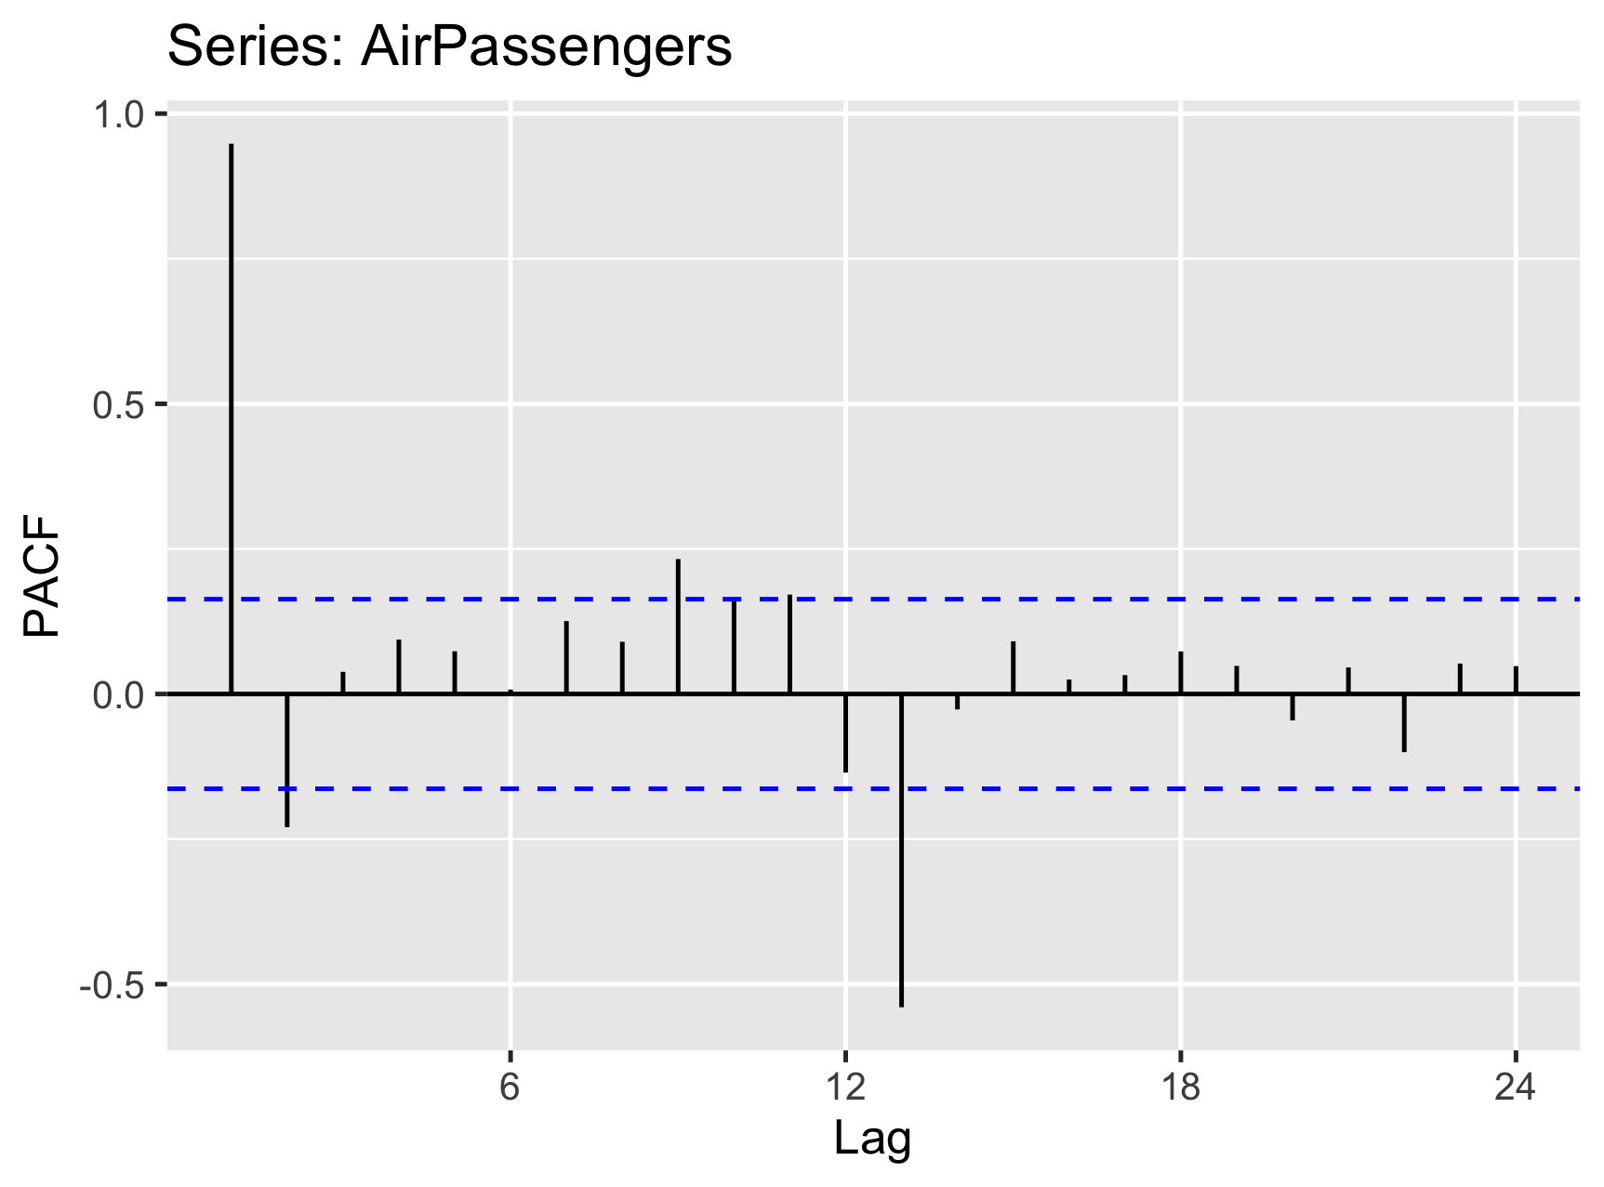



Partial Auto-Correlation Function (PACF)
$$S_{t−2}$$
$$S_{t−1}$$
$$S_{t}$$
direct correlation
Notes:
“A partial autocorrelation is a summary of the relationship between an observation in a time series with observations at prior time steps with the relationships of intervening observations removed.”
The autocorrelation for an observation and an observation at a prior time step is comprised of both the direct correlation and indirect correlations. These indirect correlations are a linear function of the correlation of the observation, with observations at intervening time steps.
It is these indirect correlations that the partial autocorrelation function seeks to remove. - https://machinelearningmastery.com/gentle-introduction-autocorrelation-partial-autocorrelation/

Slide 16
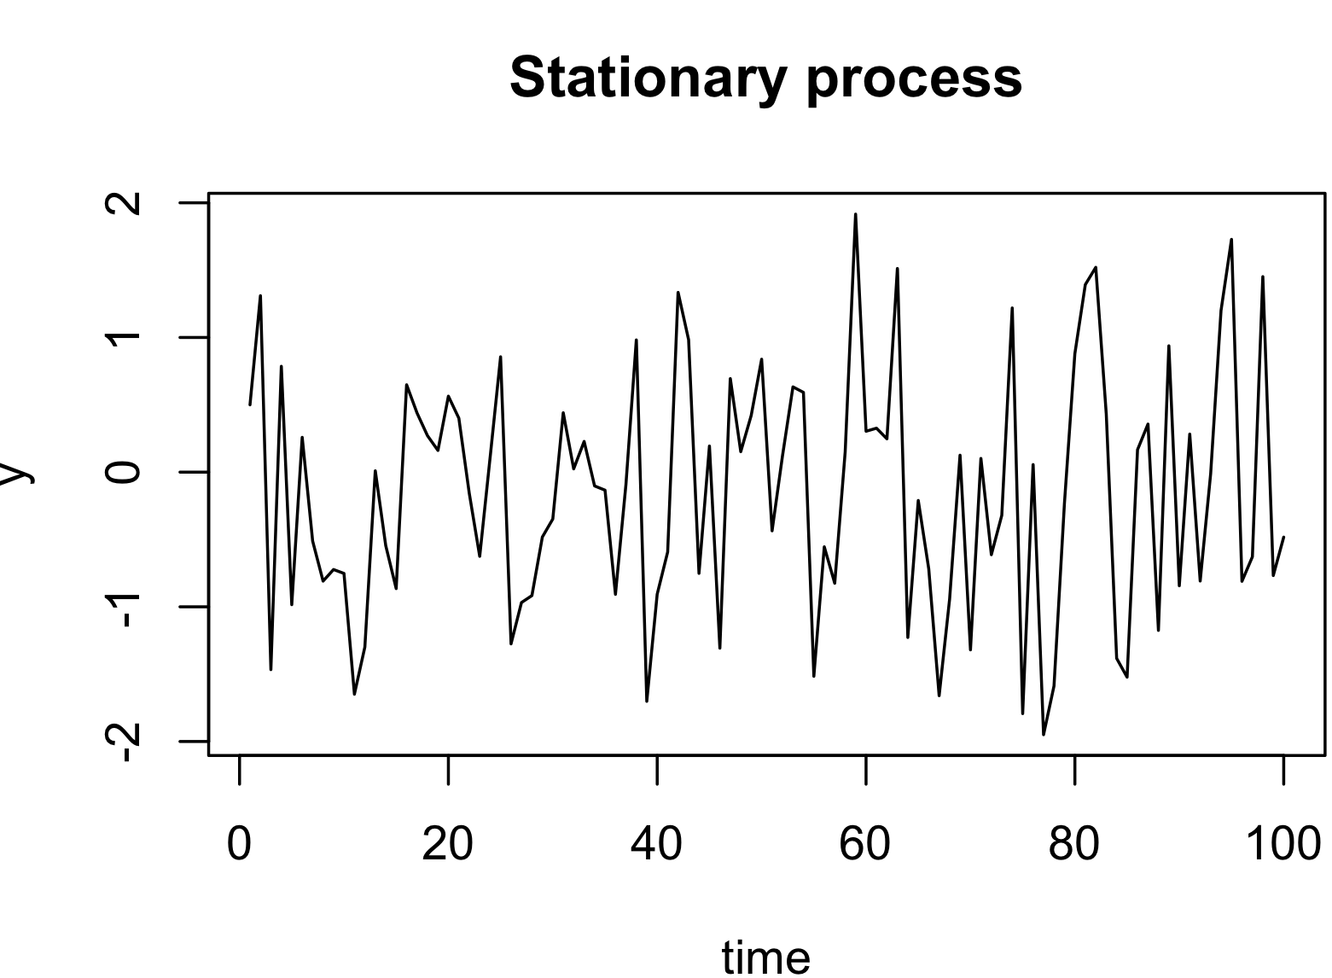
Stationary process
for all t, θ ∈ ℝ and n∈ℕ
Notes:
A stationary process is invariant to shifts in time.
Have a stable mean & variance (const) without seasonality
Have a constant autocorrelation structure (current value being dependent on past value)
Are easier to model
White noise is such an example
For a stationary timeseries, the ACF will drop to zero relatively quickly, while the ACF of non-stationary data decreases slowly. Also, for non-stationary data, the value of r1 is often large and positive.

Slide 17
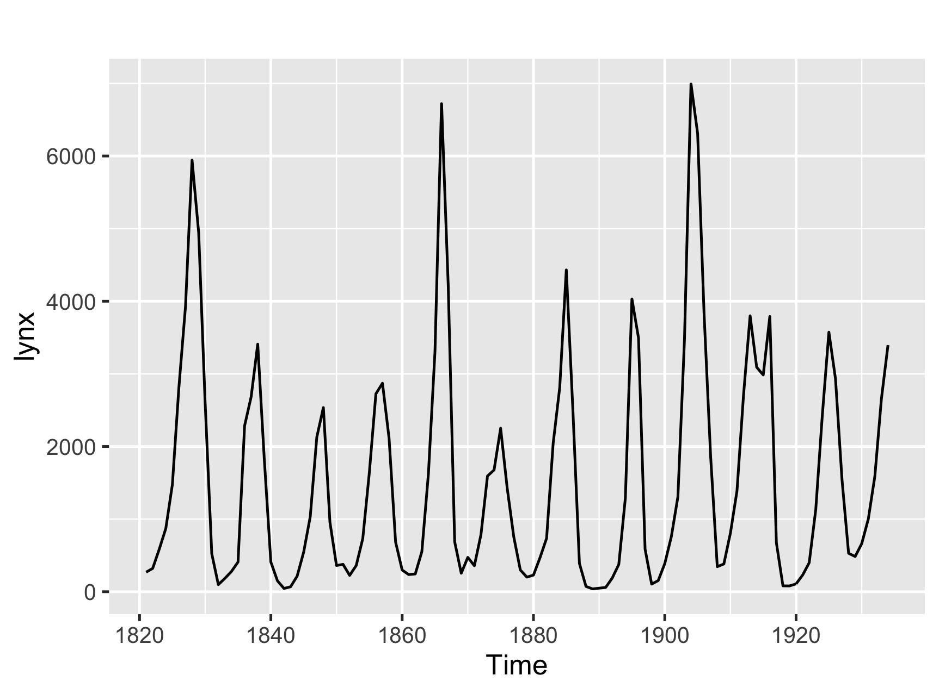
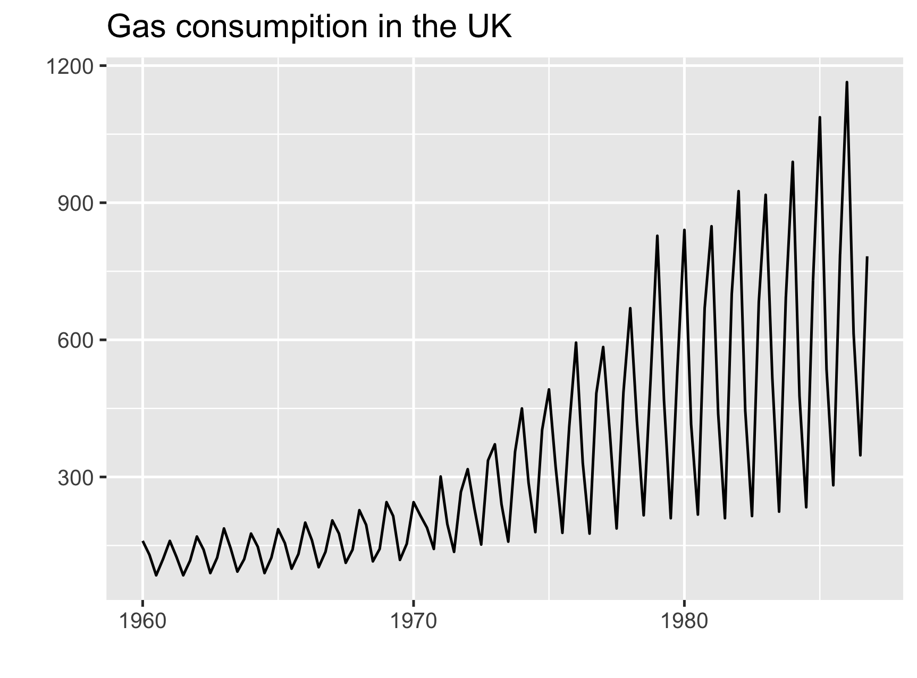
Stationary process: Exercise
Stationary
Non-stationary
Lynx population

Slide 18
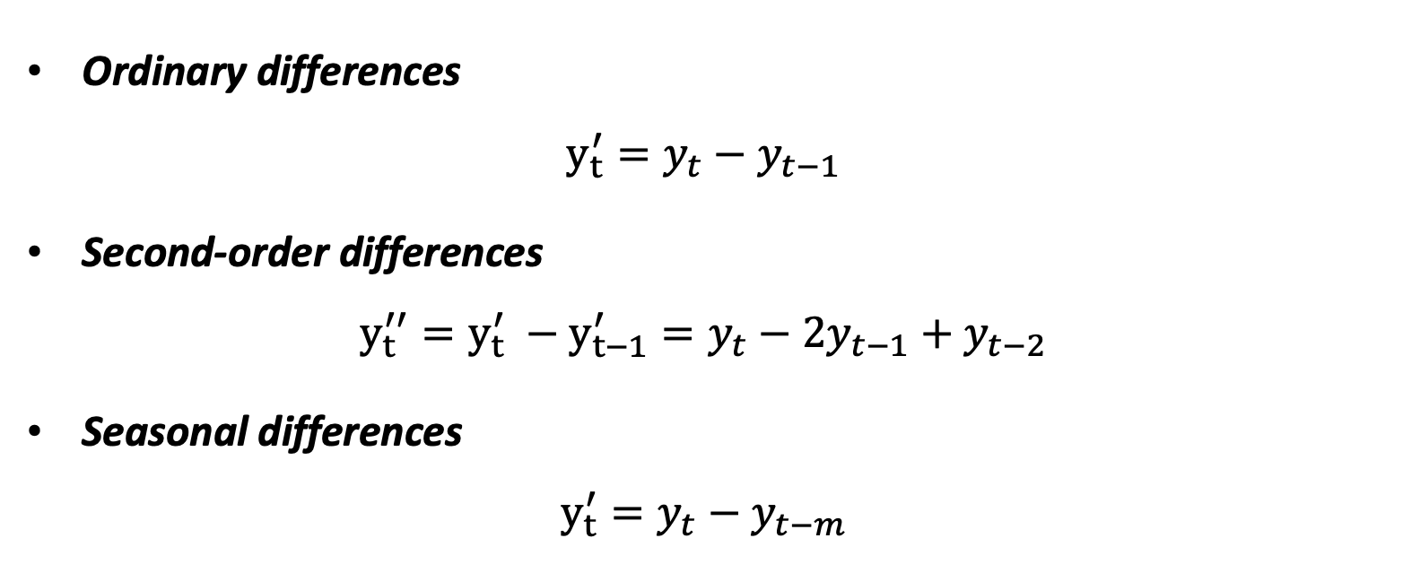
Differencing
Ordinary differences
$$y_{t}^{′}=y_{t}−y_{t−1}$$
Second-order differences $y_{t}^{′′}={y_{t}^{′} −y_{t−1}^{′}=y}_{t}−{2y}_{t−1}+y_{t−2}$
Seasonal differences $y_{t}^{′}=y_{t}−y_{t−m}$
Notes:
Transforms a non-stationary dataset into a stationary one by computing differences between consecutive observations
“Transformations such as logarithms can help to stabilise the variance of a time series. Differencing can help stabilise the mean of a time series by removing changes in the level of a time series, and therefore eliminating (or reducing) trend and seasonality.”

Slide 19
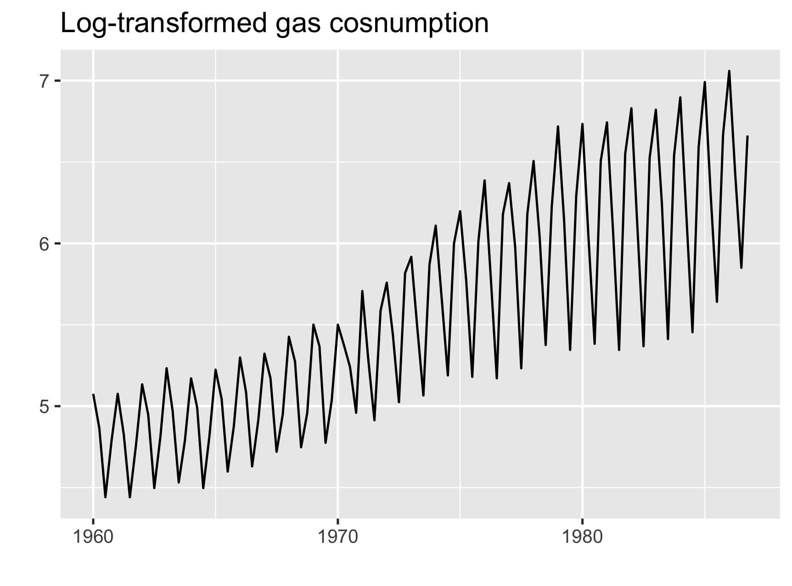
Differencing: Example
Original Data (non-stationary)
Log-transformed data (non-stationary)

Slide 20
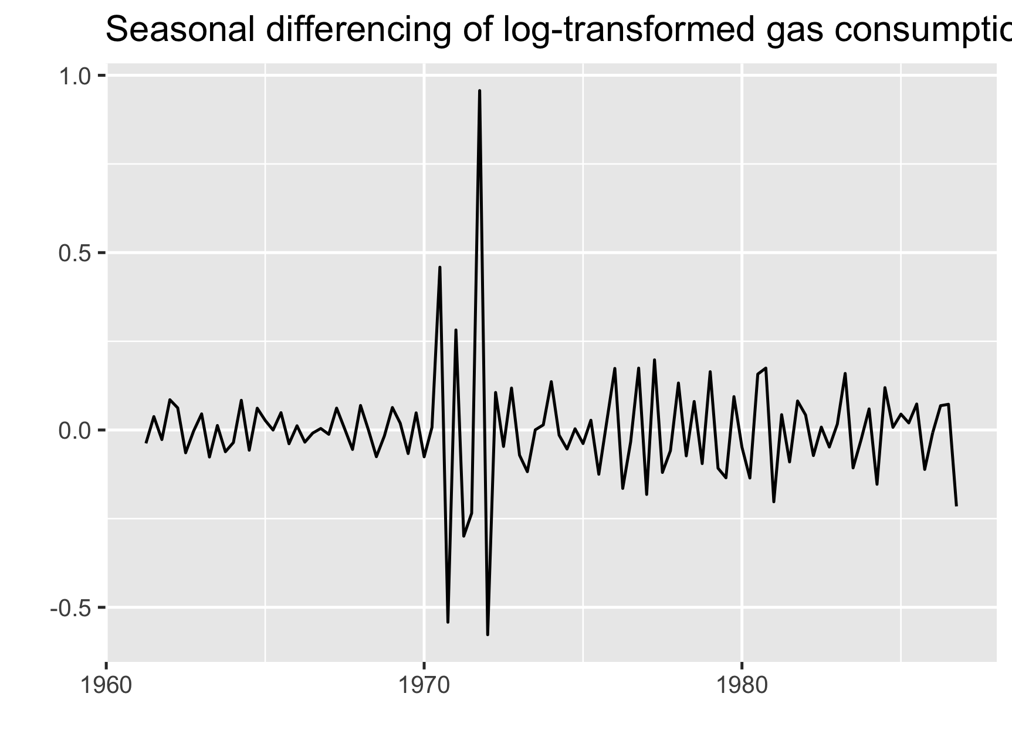
Differencing: Example
Log-transformed data (non-stationary)
Seasonally differenced data (stationary as if?)

Slide 21
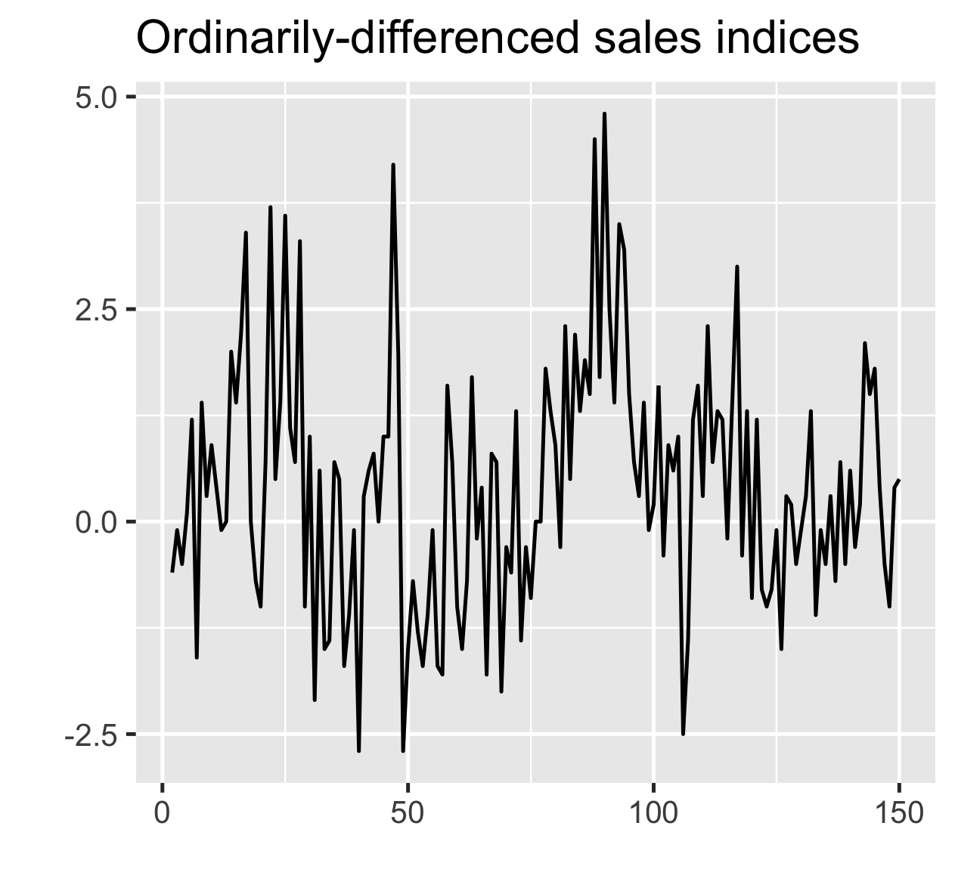
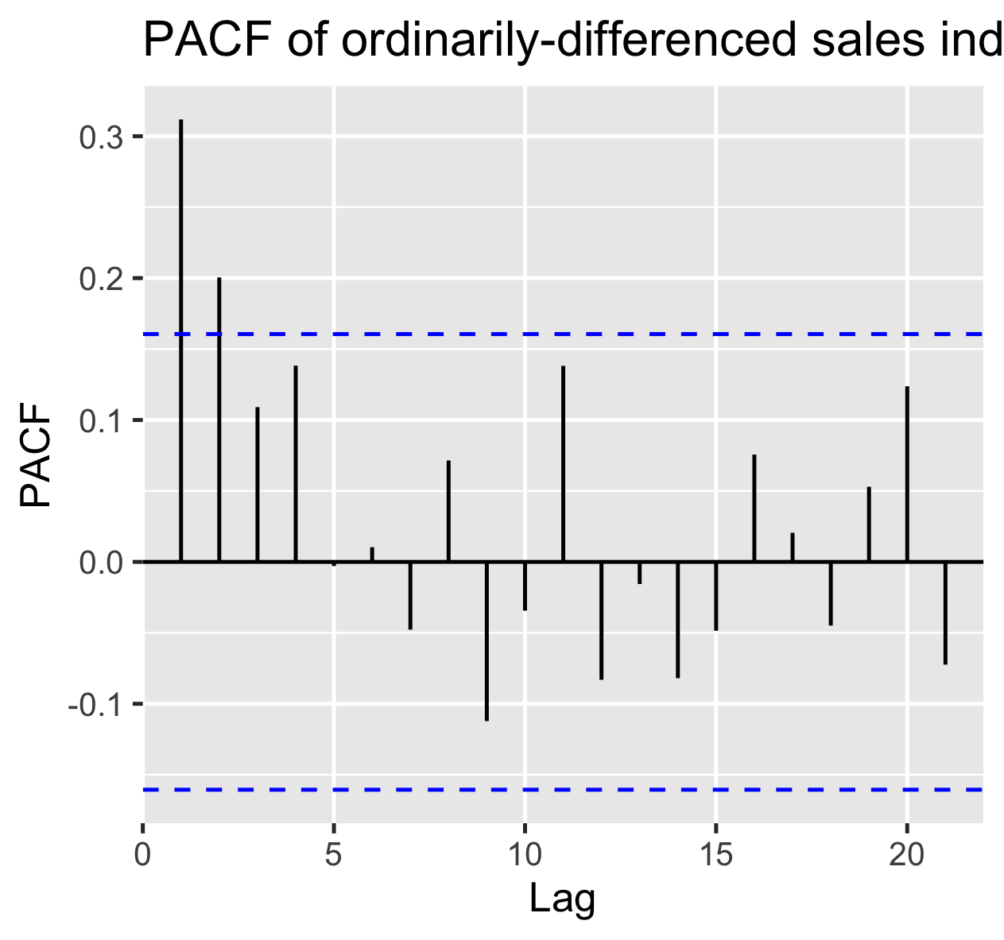
Autoregression models: Definition
AR(p) =
AR(2)
Notes:
“In an autoregression model, we forecast the variable of interest using a linear combination of past values of the variable. The term autoregression indicates that it is a regression of the variable against itself.”
“the ACF is exponentially decaying or sinusoidal
there is a significant spike at lag p in the PACF, but none beyond lag p.

Slide 22

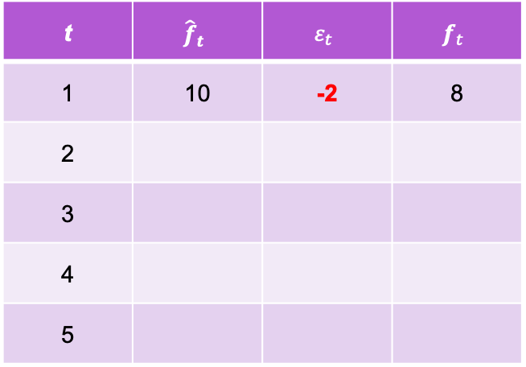
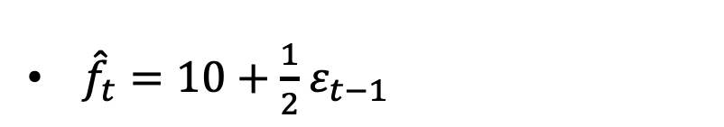
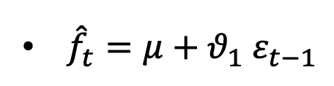
Moving average models: Intuition
A mad professor invites everyone on a cupcake party every month.
t | $${\hat{f}}_{t}$$ | $$ε_{t}$$ | $$f_{t}$$
1 | 10 | -2 | 8
2
3
4
5
${\hat{f}}_{t}=μ+θ_{1}$ $ε_{t−1}$
${\hat{f}}_{t}=10+\frac{1}{2}$ $ε_{t−1}$
https://www.youtube.com/watch?v=voryLhxiPzE&list=PLvcbYUQ5t0UHOLnBzl46_Q6QKtFgfMGc3&index=12

Slide 23
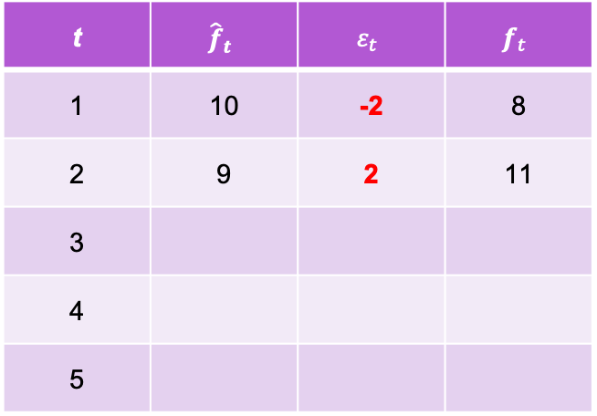
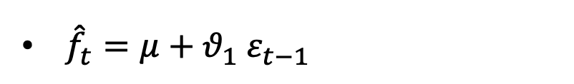
Moving average models: Intuition
A mad professor invites everyone on a cupcake party every month.
t | $${\hat{f}}_{t}$$ | $$ε_{t}$$ | $$f_{t}$$
1 | 10 | -2 | 8
2 | 9 | 2 | 11
3
4
5
${\hat{f}}_{t}=μ+θ_{1}$ $ε_{t−1}$
${\hat{f}}_{t}=10+\frac{1}{2}$ $ε_{t−1}$
https://www.youtube.com/watch?v=voryLhxiPzE&list=PLvcbYUQ5t0UHOLnBzl46_Q6QKtFgfMGc3&index=12

Slide 24
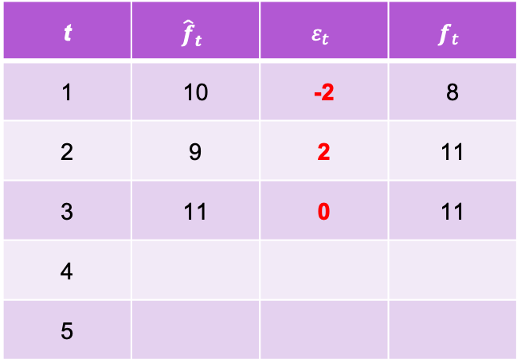
Moving average models: Intuition
A mad professor invites everyone on a cupcake party every month.
t | $${\hat{f}}_{t}$$ | $$ε_{t}$$ | $$f_{t}$$
1 | 10 | -2 | 8
2 | 9 | 2 | 11
3 | 11 | 0 | 11
4
5
${\hat{f}}_{t}=μ+θ_{1}$ $ε_{t−1}$
${\hat{f}}_{t}=10+\frac{1}{2}$ $ε_{t−1}$
https://www.youtube.com/watch?v=voryLhxiPzE&list=PLvcbYUQ5t0UHOLnBzl46_Q6QKtFgfMGc3&index=12

Slide 25
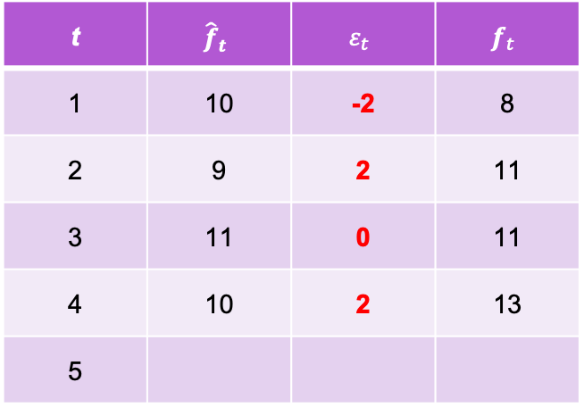
Moving average models: Intuition
A mad professor invites everyone on a cupcake party every month.
t | $${\hat{f}}_{t}$$ | $$ε_{t}$$ | $$f_{t}$$
1 | 10 | -2 | 8
2 | 9 | 2 | 11
3 | 11 | 0 | 11
4 | 10 | 2 | 13
5
${\hat{f}}_{t}=μ+θ_{1}$ $ε_{t−1}$
${\hat{f}}_{t}=10+\frac{1}{2}$ $ε_{t−1}$
https://www.youtube.com/watch?v=voryLhxiPzE&list=PLvcbYUQ5t0UHOLnBzl46_Q6QKtFgfMGc3&index=12

Slide 26
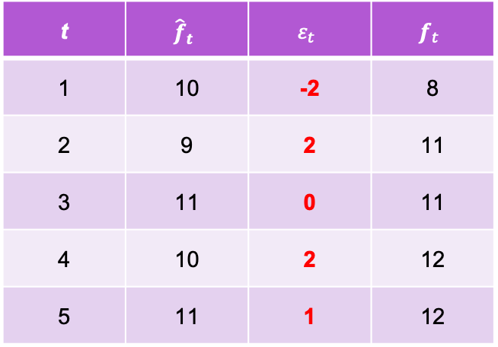
Moving average models: Intuition
A mad professor invites everyone on a cupcake party every month.
t | $${\hat{f}}_{t}$$ | $$ε_{t}$$ | $$f_{t}$$
1 | 10 | -2 | 8
2 | 9 | 2 | 11
3 | 11 | 0 | 11
4 | 10 | 2 | 12
5 | 11 | 1 | 12
${\hat{f}}_{t}=μ+θ_{1}$ $ε_{t−1}$
${\hat{f}}_{t}=10+\frac{1}{2}$ $ε_{t−1}$
https://www.youtube.com/watch?v=voryLhxiPzE&list=PLvcbYUQ5t0UHOLnBzl46_Q6QKtFgfMGc3&index=12

Slide 27
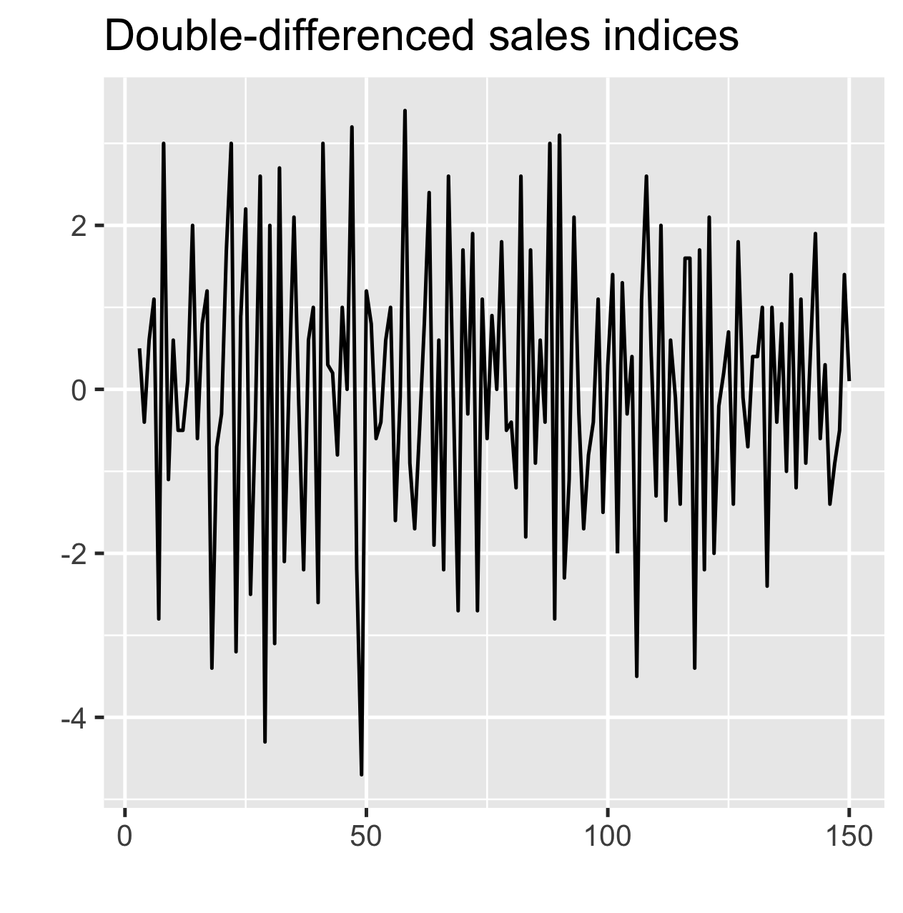
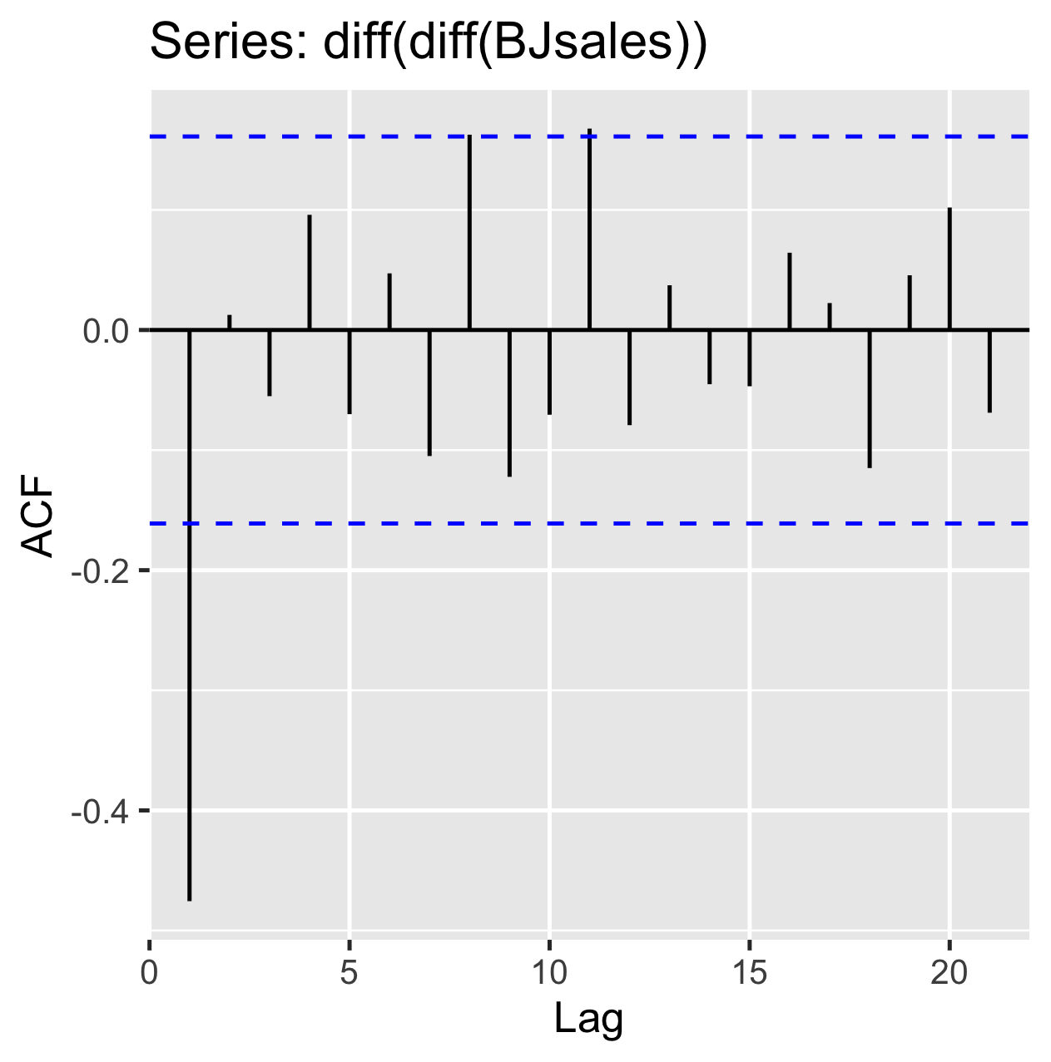
Moving average models: Definition
MA(q) =
MA(1)
Notes:
-” Rather than using past values of the forecast variable in a regression, a moving average model uses past forecast errors in a regression-like model.”
εt is white noise, which means normally distributed with mean 0, std 1
“we do not observe the values of εt, so it is not really a regression in the usual sense”
” The autocorrelation function (ACF) of an MA(q) process is zero at lag q + 1 and greater. Therefore, we determine the appropriate maximum lag for the estimation by examining the sample autocorrelation function to see where it becomes insignificantly different from zero for all lags beyond a certain lag, which is designated as the maximum lag q.” - wiki
“One or more spikes, rest are essentially zero (or close to zero) Moving average model, order identified by where plot becomes zero.”
“the PACF is exponentially decaying or sinusoidal;”
“there is a significant spike at lag q in ACF, but none beyond lag q.”
For example:
Series: diff(diff(BJsales))
ARIMA(0,0,1) with zero mean
Coefficients:
ma1
-0.7480
s.e. 0.0662

Slide 28
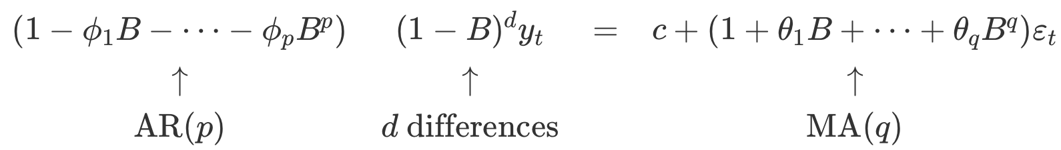

ARIMA (non-seasonal) models
ARIMA(p,d,q) =
Revision
B shifts data back one period
$By_{t}=y_{t−1}$
$B\left(By_{t}\right)=B^{2}y_{t}=y_{t−2}$
$B^{12}y_{t}=y_{t−12}$
Notes:
AR – Auto-Regressive
I – Integrated (Inverse of differencing)
MA – Moving Average

